Slide 1
Efficiency with NBA Player Contracts
Research by: Dalton Price & Zach Rickman

Slide 2
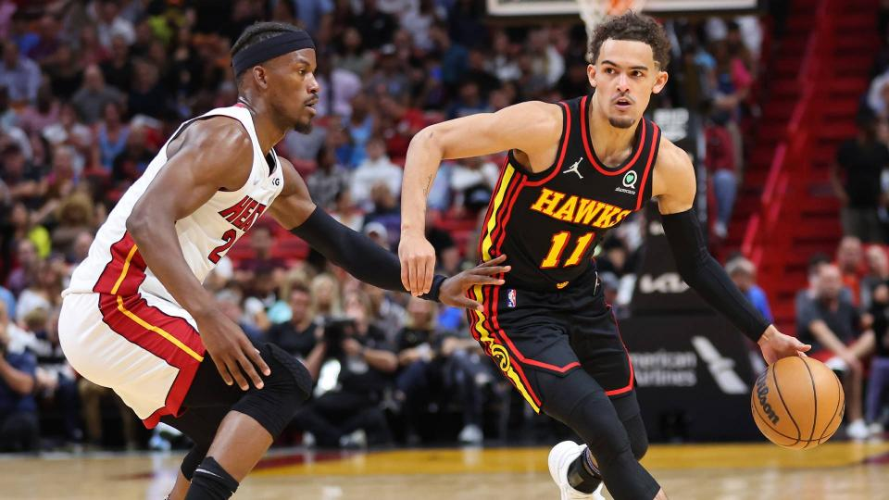
What was our goal?
In our project we set out to identify a correlation between how much an NBA player is paid and/or their age, to various factors with their production on the court.
Null hypothesis: If a player is paid more and, is more experienced, then their stats are more productive.
Alternative: Salary and/or age have no correlation to the productivity of a player.

Slide 3
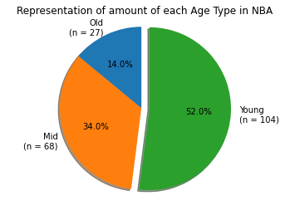
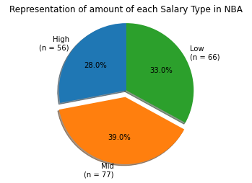
Data Context
Young = x < 25
Mid = 25 > x > 29
Old = x > 29
Low = x < 6 Mil
Mid = 6 Mil > x > 15 Mil
Old = x > 30 Mil

Slide 4
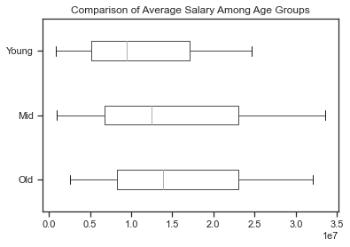
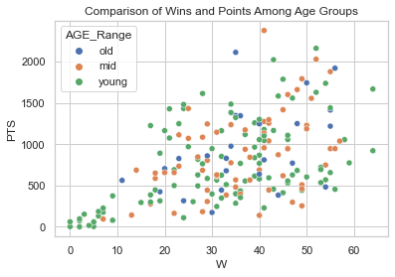
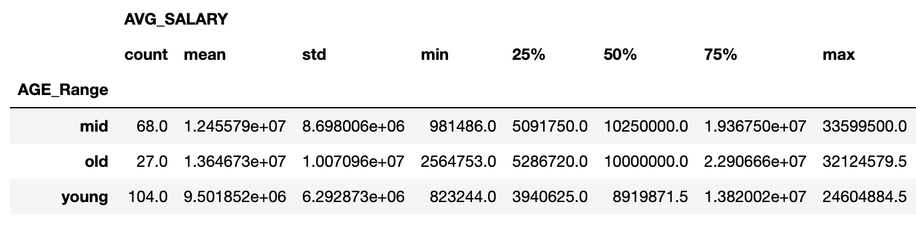
Data comparison for age groups

Slide 5
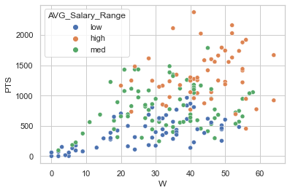
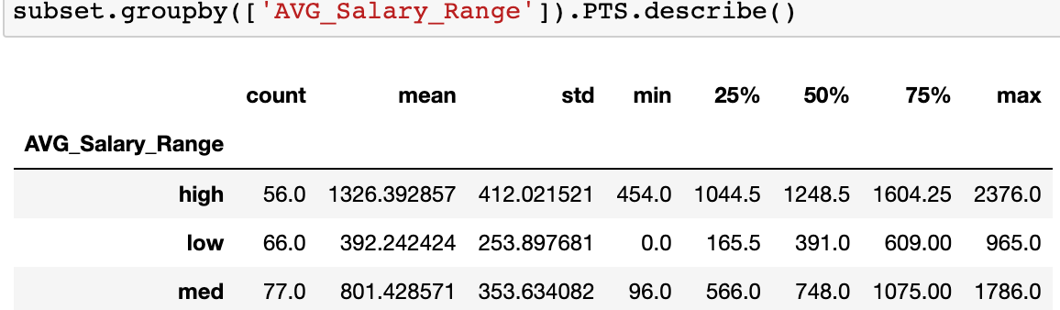
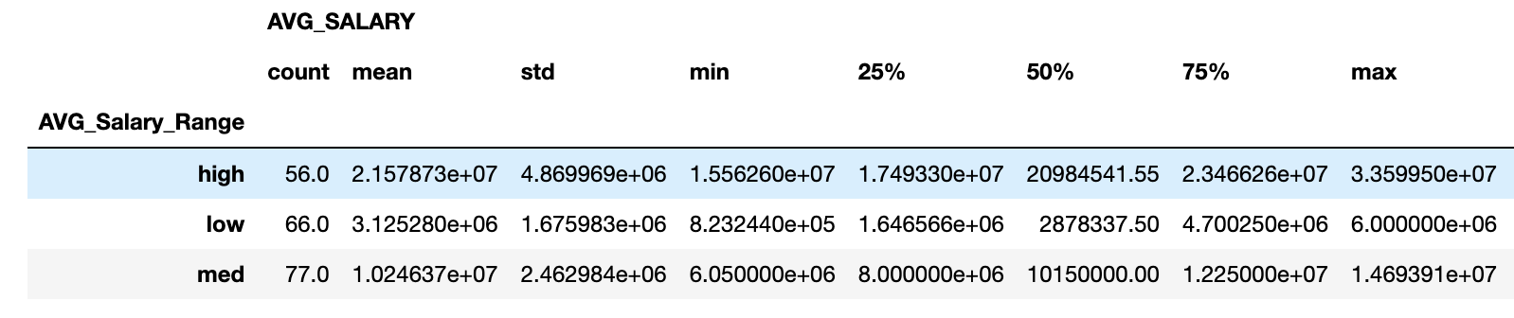
Data comparison for salary groups

Slide 6
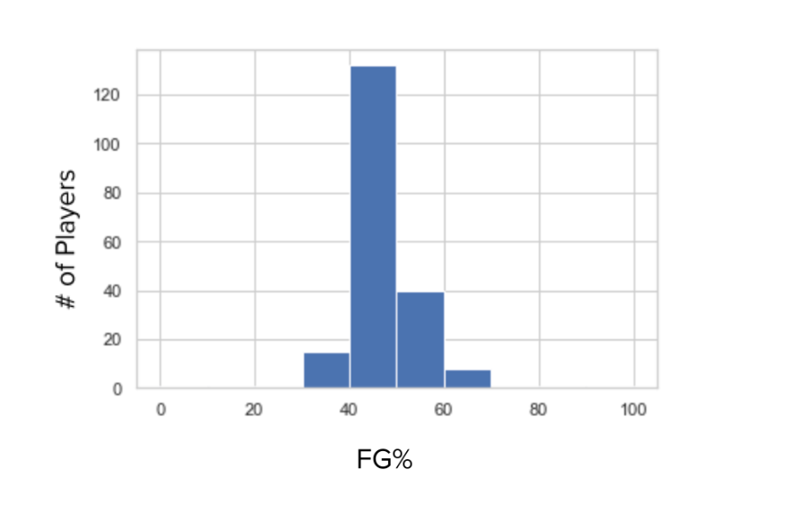
ANOVA Research
Normality Tests
These tests show that the High and Mid Salary Ranges consist of values with normal distribution regarding FG%
normaltest(H)
NormaltestResult(statistic=26.385633462656486, p value=1.86394e-06)
normaltest(M)
NormaltestResult(statistic=18.782768128629115, p value=8.343989e-09)
normaltest(L)
NormaltestResult(statistic=39.9474826386561, p value=2.115993e-05)
Equal Variance Test
LeveneResult(statistic=1.302824534530697, p value=0.2741059494835371)

Slide 7
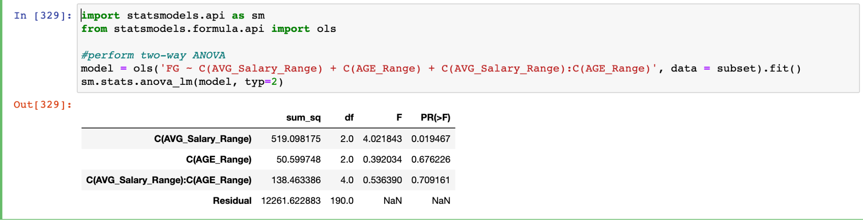
Dialing in on the FG% Data
These tests show that the High and Mid Salary Ranges consist of values with normal distribution regarding FG%. FG% was the only variable that we could find that was this normally distributed. This concludes us to believe that stars and medium paid players score at a higher efficiency rating, which proves our original hypothesis.
On average it is worth it to pay your most productive players

Slide 8
Conclusion
When it comes to the correlation between a player’s salary and their age, our data shows that it does exist, however in not in the way we originally anticipated. We expected younger players to get paid more, however the older and middle aged players on average were paid more. They also had a slightly higher FG% on average which can attribute to their success.
It also shows that age does not necessarily impact success, while high salary players tend to perform better on average. Young players are not proven and do not make the same salary as “Mid” or “Old” players.
Thus, our null hypothesis was supported from our data.

